Slide 1

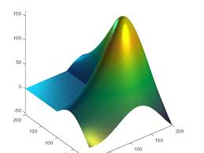
ENGR 4399 Introduction to Machine Learning for Engineers
Lecture 10 - Clustering

Slide 2
In-Class #7a: PCA
load the credit rating history data file “CreditRating.dat”
Display the Category Names for the columns
3) Perform a Principal Component Analysis to determine the which categories explain at least 95% of the data
4) Create a 2D and 3D scatter plot of the data using scatter

Slide 3
creditrating = readtable('CreditRating.dat');
creditrating.Properties.VariableNames
creditrating(1:5,:)
X = creditrating{:,2:7}; %convert from Table to Numerical, note curly brackets!
X1 = table2array(creditrating(:,2:7)) %another way to get numerical data from Table
[pcs,scrs,~,~,pexp] = pca(X);
pareto(pexp)
scatter(scrs(:,1),scrs(:,2))
scatter3(scrs(:,1),scrs(:,2),scrs(:,3))

Slide 4
k-means
Most well-known and popular clustering algorithm:
Start with some initial cluster centers
Iterate:
Assign/cluster each example to closest center
Recalculate centers as the mean of the points in a cluster

Slide 5
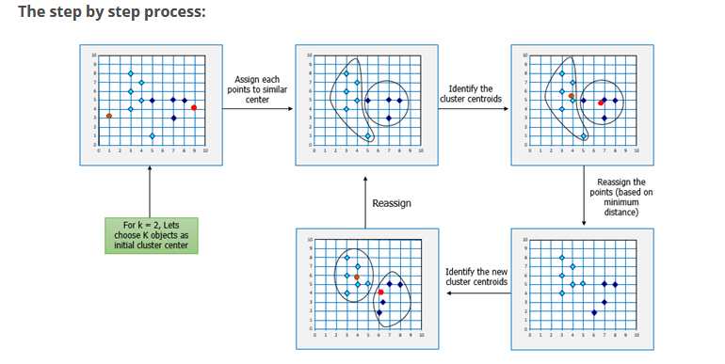
k-means process flow

Slide 6
k-means: an example

Slide 7
k-means: Initialize centers randomly

Slide 8
k-means: assign points to nearest center

Slide 9
k-means: readjust centers

Slide 10
k-means: assign points to nearest center

Slide 11
k-means: readjust centers

Slide 12
k-means: assign points to nearest center

Slide 13
k-means: readjust centers

Slide 14
k-means: assign points to nearest center
No changes: Done

Slide 15
k-means
Iterate:
Assign points to the closest center
Recalculate centers as the mean of the points in a cluster

Slide 16
k-means
Iterate:
Assign/cluster each example to closest center
Recalculate centers as the mean of the points in a cluster
iterate over each point:
- get distance to each cluster center
- assign to closest center
What distance measure should we use?

Slide 17
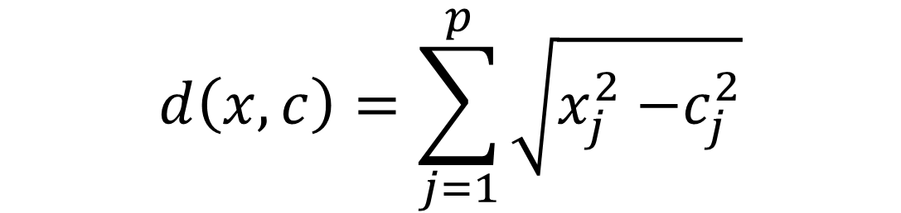
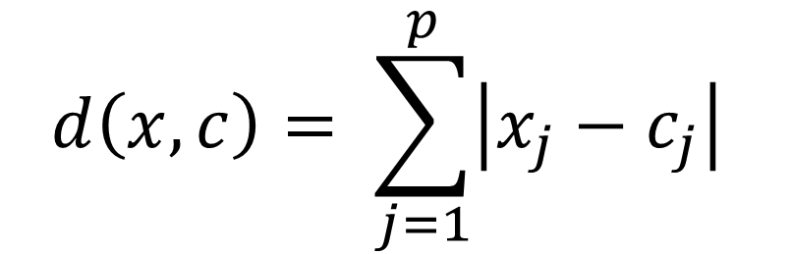
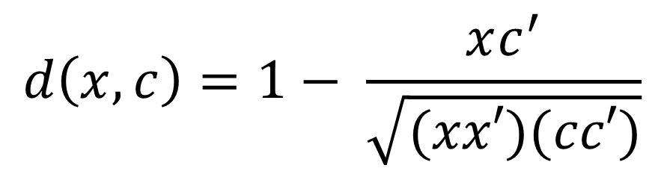
How we measure distance
Euclidean (default in MATLAB:
$$d\left(x,c\right)=\sum_{j=1}^{p}{\sqrt{x_{j}^{2}{−c}_{j}^{2}}}$$
City Block:
$$d\left(x,c\right)= \sum_{j=1}^{p}{\left|x_{j}−c_{j}\right|}$$
Cosine:
$$d\left(x,c\right)=1− \frac{xc^{′}}{\sqrt{(xx′)(cc′)}}$$

Slide 18
k-means
Iterate:
Assign points to the closest center
Recalculate centers as the mean of the points in a cluster
Where are the cluster centers?

Slide 19
k-means
Iterate:
Assign/cluster each example to closest center
Recalculate centers as the mean of the points in a cluster
How do we calculate these?

Slide 20
k-means
Iterate:
Assign/cluster each example to closest center
Recalculate centers as the mean of the points in a cluster
Mean of the points in the cluster:

Slide 21
What is k-means doing?
k-means tries to minimize what is called the “k-means” loss function:
that is, the sum of the squared distances from each point to the associated cluster center

Slide 22
Minimizing k-means loss
Iterate:
1. Assign/cluster each example to closest center
2. Recalculate centers as the mean of the points in a cluster
Does each step of k-means move towards reducing this loss function (or at least not increasing)?

Slide 23
k-means++ (MATLAB)
μ₁ = pick random point
for k = 2 to K:
for i = 1 to N:
s_{i} = min d(x_{i}, μ_{1…k-1})
% smallest distance to any center

Slide 24
In-Class #7b: k-means
load the basket ball stats data file called “bball.txt”
2) Save all the numerical categories from “bball.txt” into a variable called “stats”
3) Normalize the values in your “stats” variable by using the MATLAB function zscore and save it in a new variable called “statsNorm”
4) Perform a kmeans clustering analysis with 2 clusters using a distance that provides the “smallest total sum of distances” using “statsNorm”

Slide 25
%% Import & intialize data
data = readtable('bball.txt');
stats = data{:,[ 5 6 11:end ]};
labels = data.Properties.VariableNames([ 5 6 11:end ]);
statsNorm = zscore(stats);
%% TODO: Group data using k-means clustering
grp = kmeans(statsNorm,2,'Distance','cityblock','Replicates',5,'Display','final');
grp = kmeans(statsNorm,2,'Distance','sqeuclidean','Replicates',5,'Display','final');
grp = kmeans(statsNorm,2,'Distance','cosine','Replicates',5,'Display','final');
%% View data
scatter3(scrs(:,1),scrs(:,2),scrs(:,3),10,grp)

